Slide 1

Understanding Palindromic Substrings and Longest Palindrome

Slide 2

Agenda
What is a Palindrome?
Palindromic Substrings: Introduction
Brute Force Approach
Expand Around Center
Dynamic Programming Approach
Longest Palindromic Substring
Count of Palindromic Substrings
Applications
Interview Questions
Summary

Slide 3
What is a Palindrome?
A palindrome is a string that reads the same backward as forward.
Examples: "madam", "racecar", "a", "121“.
Important property: symmetry around the center.
Used in genetics, natural language processing, and string compression.

Slide 4
Palindromic Substrings - Definition
A palindromic substring is a substring of a given string which is a palindrome.
For string "ababa":
Substrings: "a", "b", "aba", "bab", "ababa" are palindromic.
Total palindromic substrings: 9

Slide 5
Problem Variants
Longest Palindromic Substring:
Input: "babad" → Output: "bab" or "aba“
Count of Palindromic Substrings:
Input: "aaa" → Output: 6 ("a", "a", "a", "aa", "aa", "aaa")

Slide 6
Brute Force Approach
Generate all possible substrings.
Check each substring for palindrome.
Use helper function to check if s[l..r] is palindrome.
Time Complexity: O(n³), Space: O(1)
Not efficient for strings > 1000 characters.

Slide 7
Expand Around Center - Concept
A palindrome is symmetric around its center.
There are 2n-1 possible centers in a string.
Expand outward from each center while characters match.
Efficient and easy to implement.

Slide 8
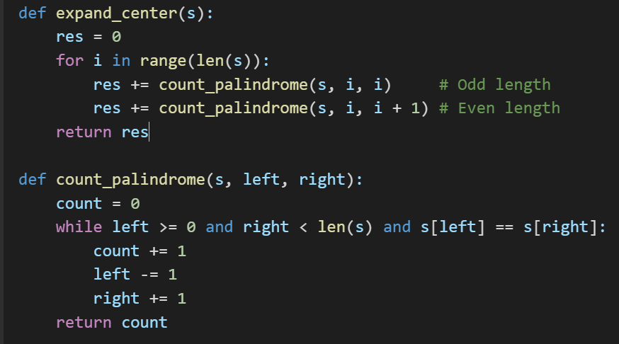
Expand Around Center - Code

Slide 9
Time and Space - Expand Around Center
Time Complexity: O(n²)
Space Complexity: O(1)
Best method for counting palindromic substrings in interviews.

Slide 10
Dynamic Programming - Concept
Use a 2D table dp[i][j]: True if substring s[i..j] is a palindrome.
Initialization:
All dp[i][i] = True (single char).
All dp[i][i+1] = True if s[i] == s[i+1]
Build for lengths 3 and more.

Slide 11
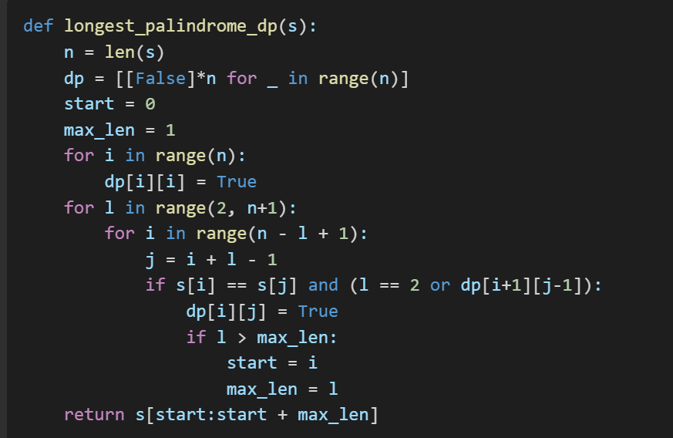
Dynamic Programming - Code

Slide 12
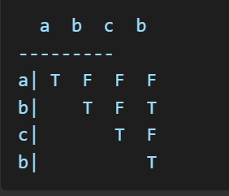
DP Table Illustration
Use example: "abcb"
Visual matrix:
Highlight longest: "bcb"

Slide 13
Time and Space - DP
Time Complexity: O(n²)
Space Complexity: O(n²)
Good for finding longest palindromic substring and storing details.

Slide 14
Count of Palindromic Substrings
Use Expand Around Center (O(n²))
For DP: count all True values in DP table.
Make sure to handle overlapping substrings.

Slide 15
Comparison of Techniques
Method | Time Complexity | Space Complexity | Suitable For | Notes
Brute Force | O(n³) | O(1) | Simple problems | Inefficient for large input
Expand Around Center | O(n²) | O(1) | Counting palindromic substrings | Easy to implement
Dynamic Programming | O(n²) | O(n²) | Finding longest palindromic substrings | Stores all intermediate results

Slide 16
Applications
Bioinformatics: DNA sequence analysis
Text Analysis: Symmetry Detection
AI/ML: Feature engineering for text
Cryptography: Pattern encoding/decoding

Slide 17
Interview Problems
Leetcode 5: Longest Palindromic Substring
Leetcode 647: Count Substrings
GFG: Palindromic Array Check
HackerRank: Special Palindrome Again

Slide 18
THANK YOU

